Slide 1

2/10 Report
By Bolun

Slide 2
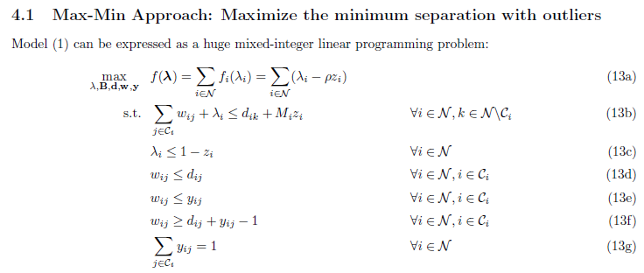
Original MILP

Slide 3
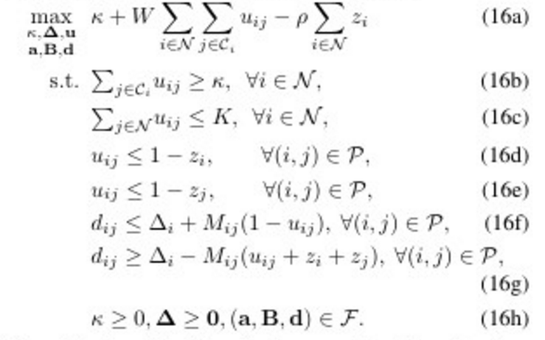
KNN in AIMMS

Slide 4
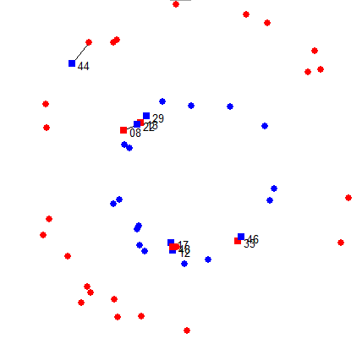
Instance # 1

Slide 5
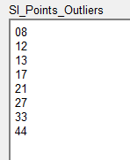
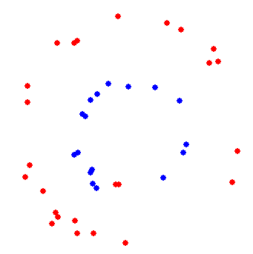
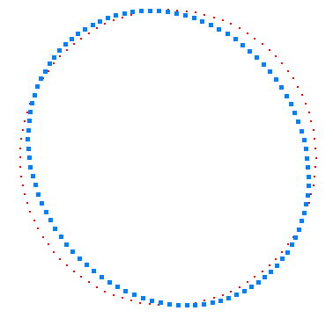

Result from our method
Distance Metrix

Slide 6
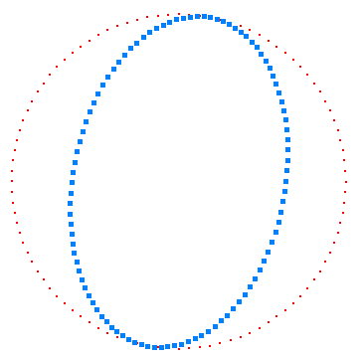
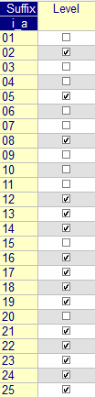
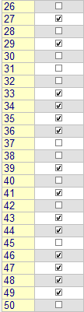

Result from MILP
In 100 sec
Distance Metrix
Outliers
Rho = 0.01
We get optimal solution = 0
if Rho is too large (suppose Rho=0.1).
29 outliers!

Slide 7
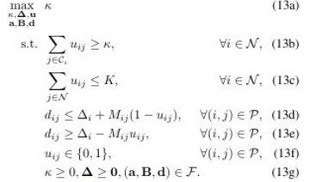
Problems in KNN formulation
We will always get optimal solution = 0
if we do not give a lower bound of B.

Slide 8
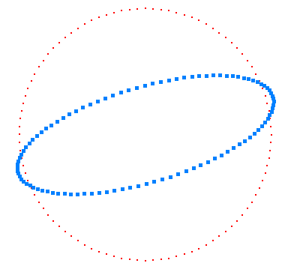

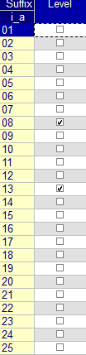
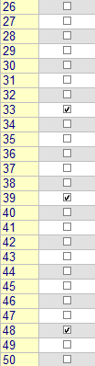
Result from KNN
In 100 sec
Make sure B(1,1) >=0. 1
Distance Metrix
Outliers
W=(NK/2)^-1=0.0044
K=3
5 outliers!

Slide 9
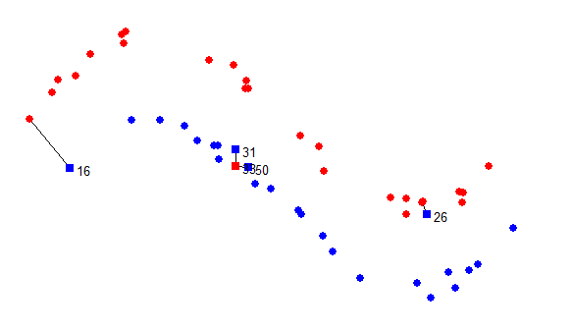
Instance # 2

Slide 10
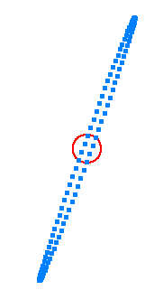

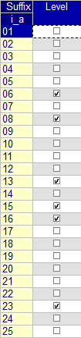
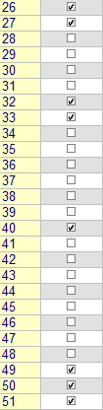
Result from MILP
In 100 sec
Distance Matrix
Outliers
Rho = 0.01
the same with Rho=0.02
We get optimal solution = 0
if Rho is too large (suppose Rho=0.1).
14 outliers!

Slide 11
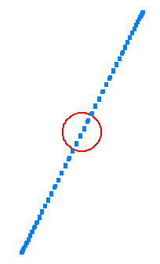

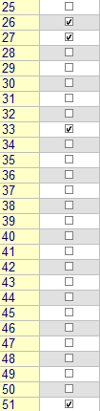


Result from KNN
In 100 sec
Make sure B(1,1) >=1
Rho=0.1
Rho=1
Distance Metrix
Rho=0.01
Outliers
Rho=0.001
W=(NK/2)^-1=0.0044
K=3
4 outliers!

Slide 12
Thank you !

